Slide 1

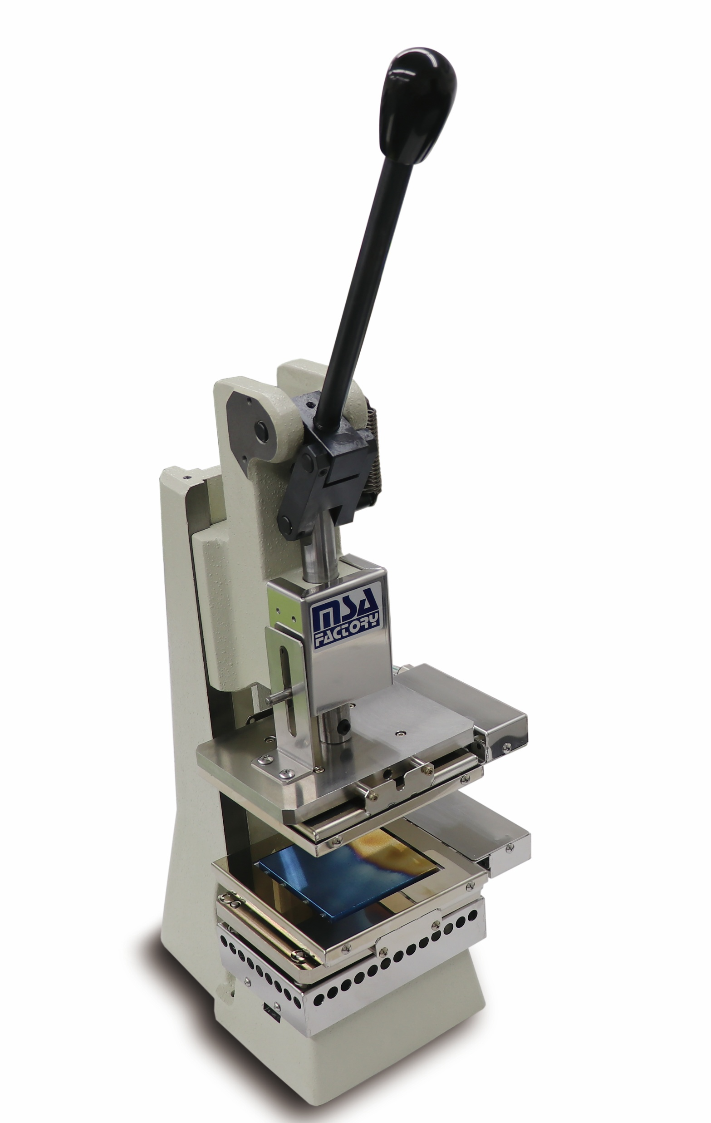
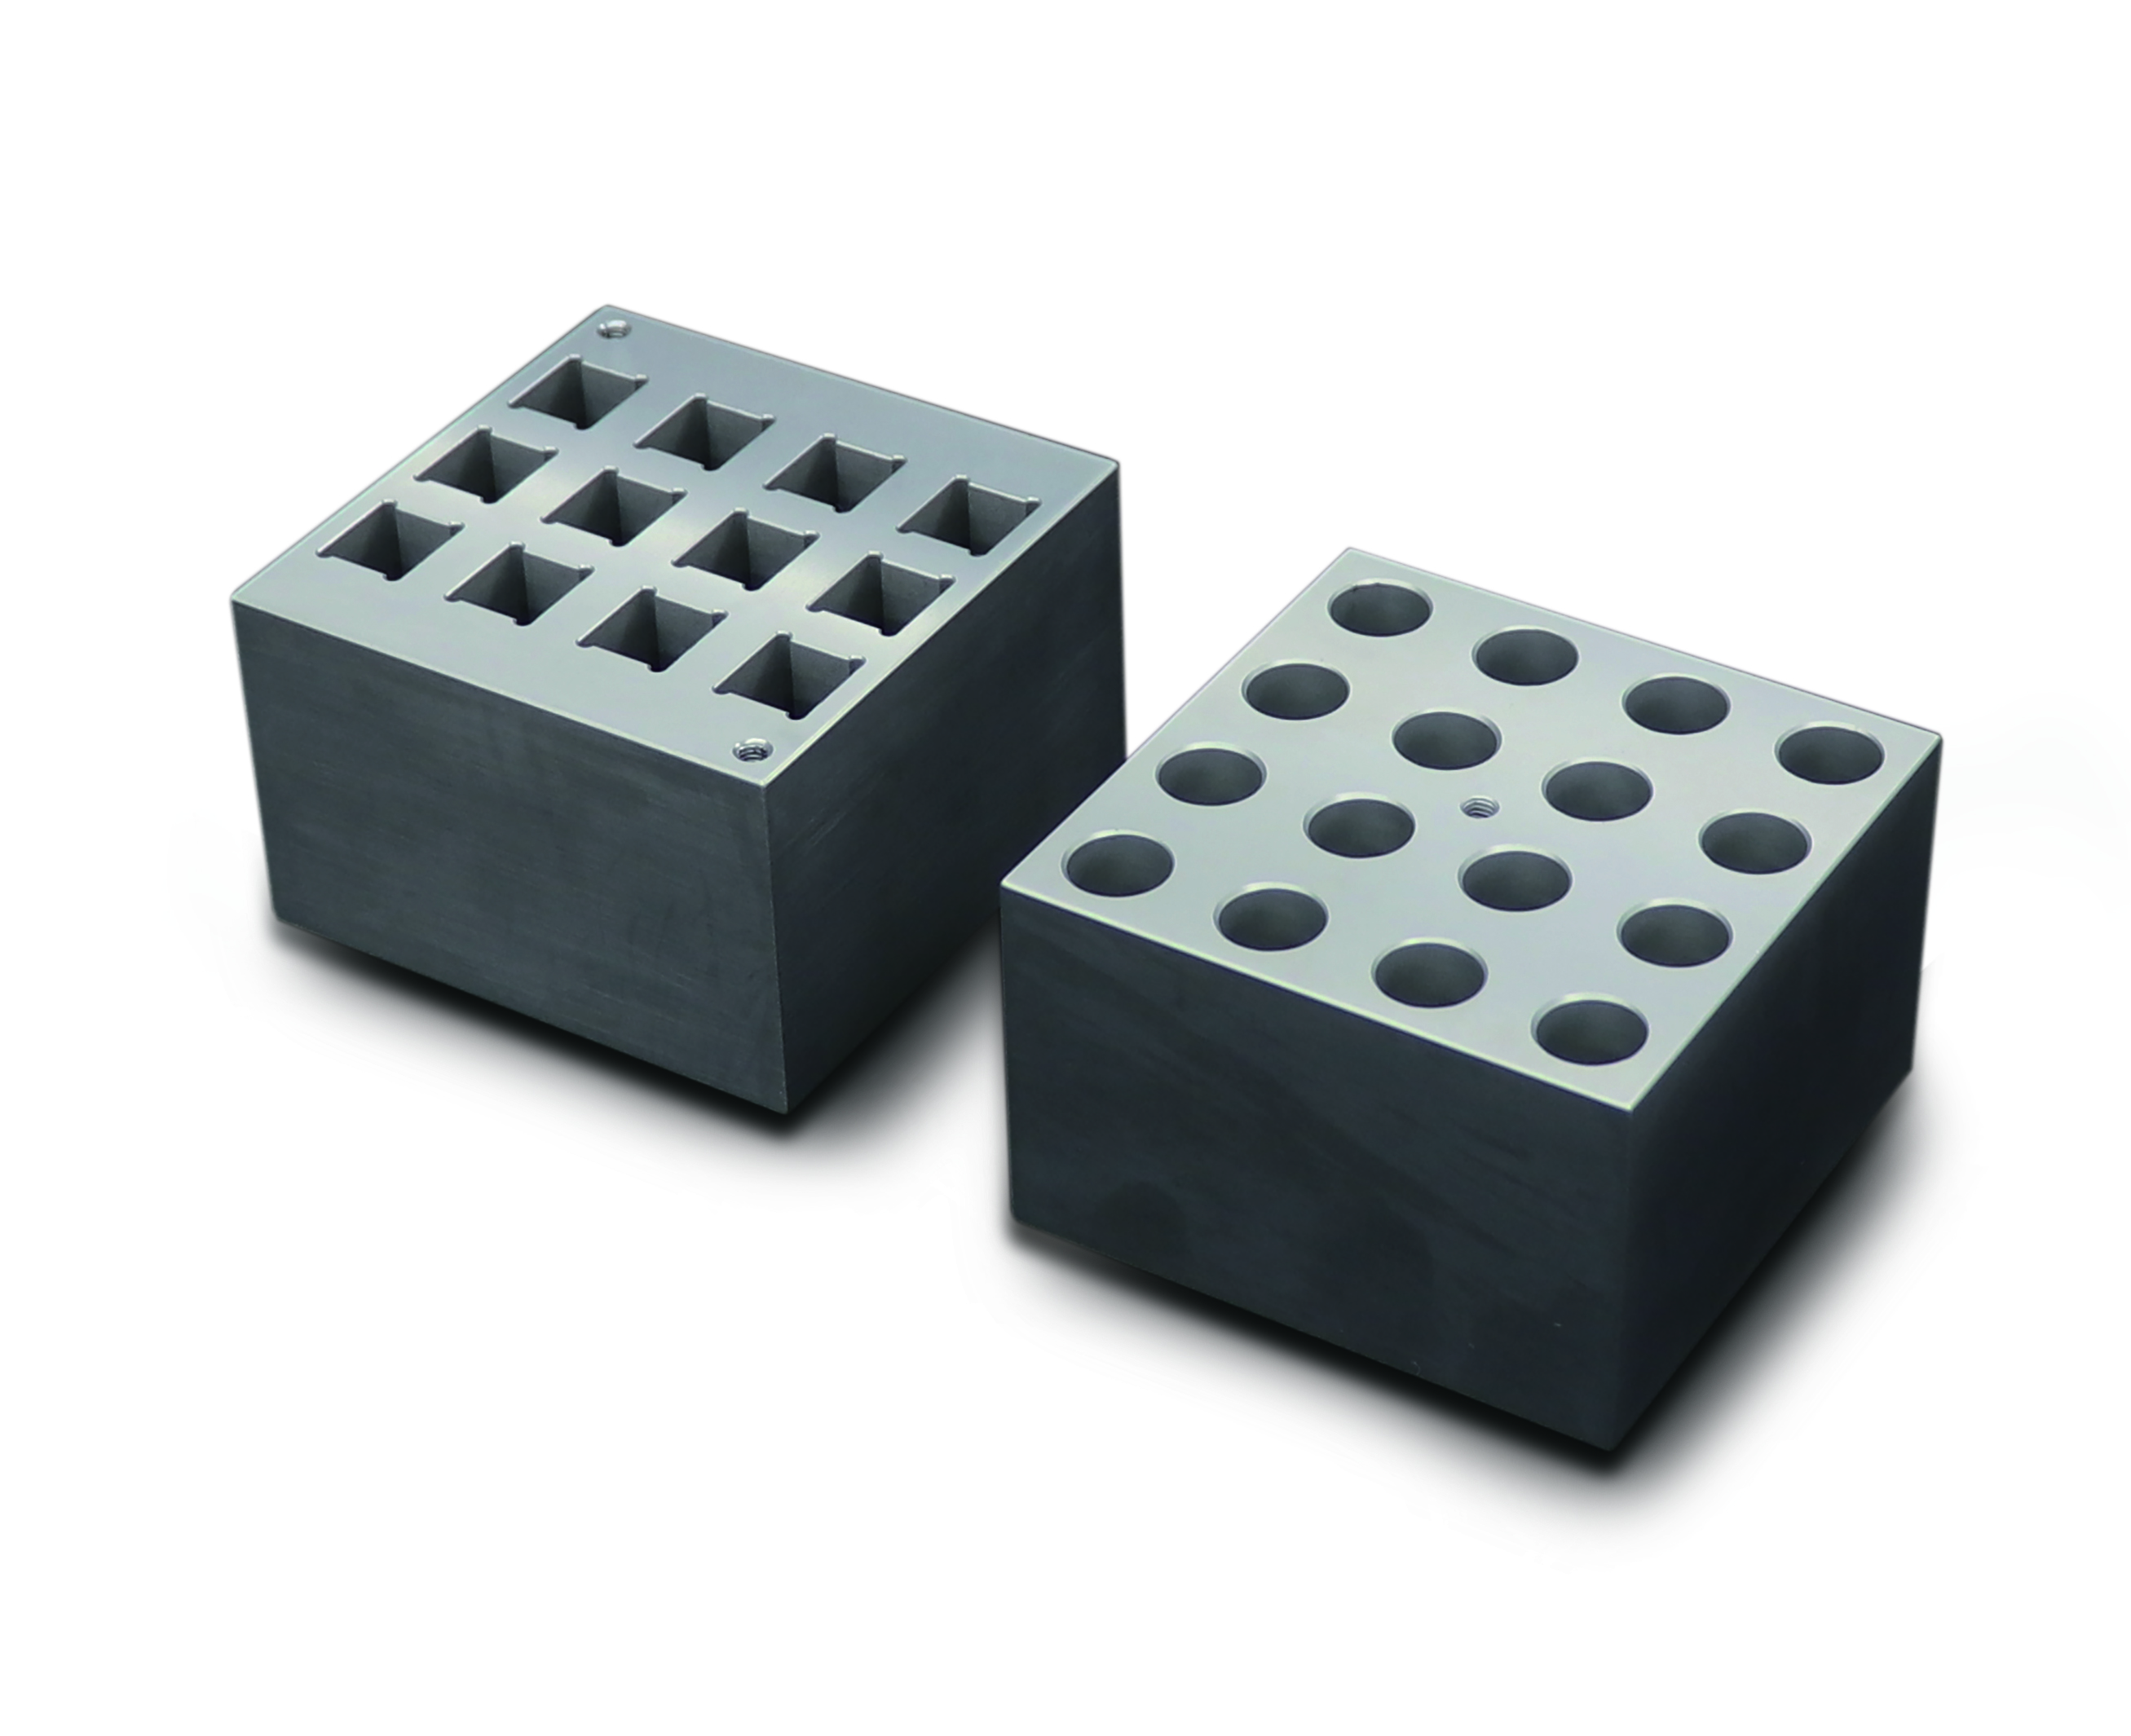
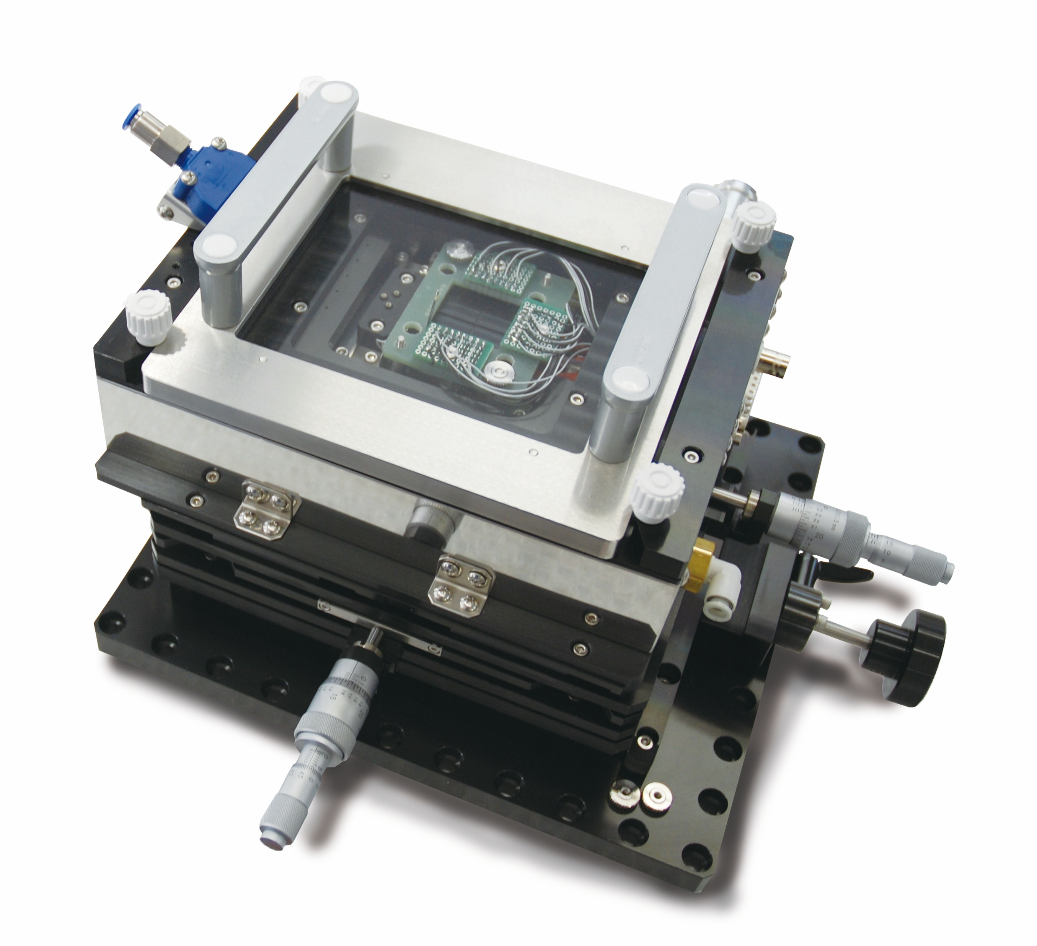
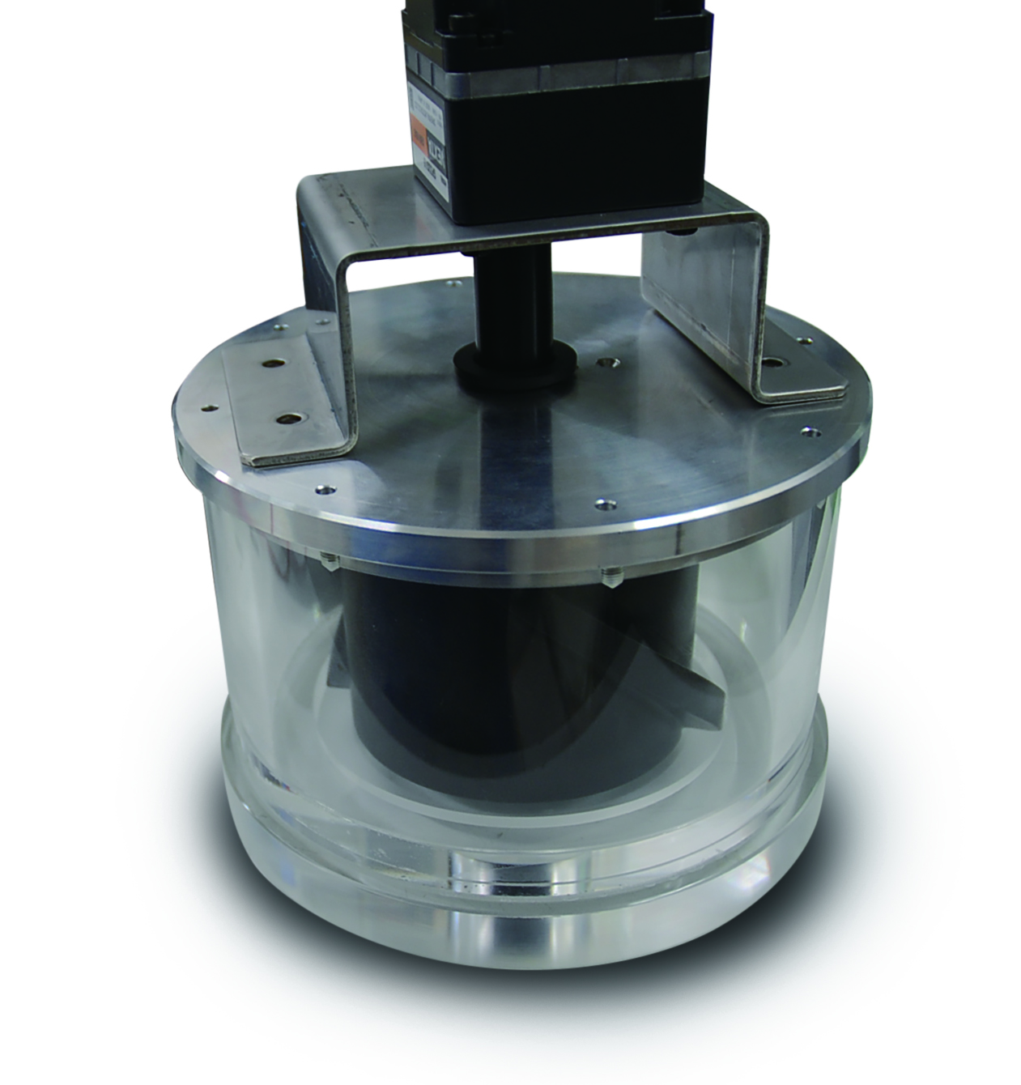
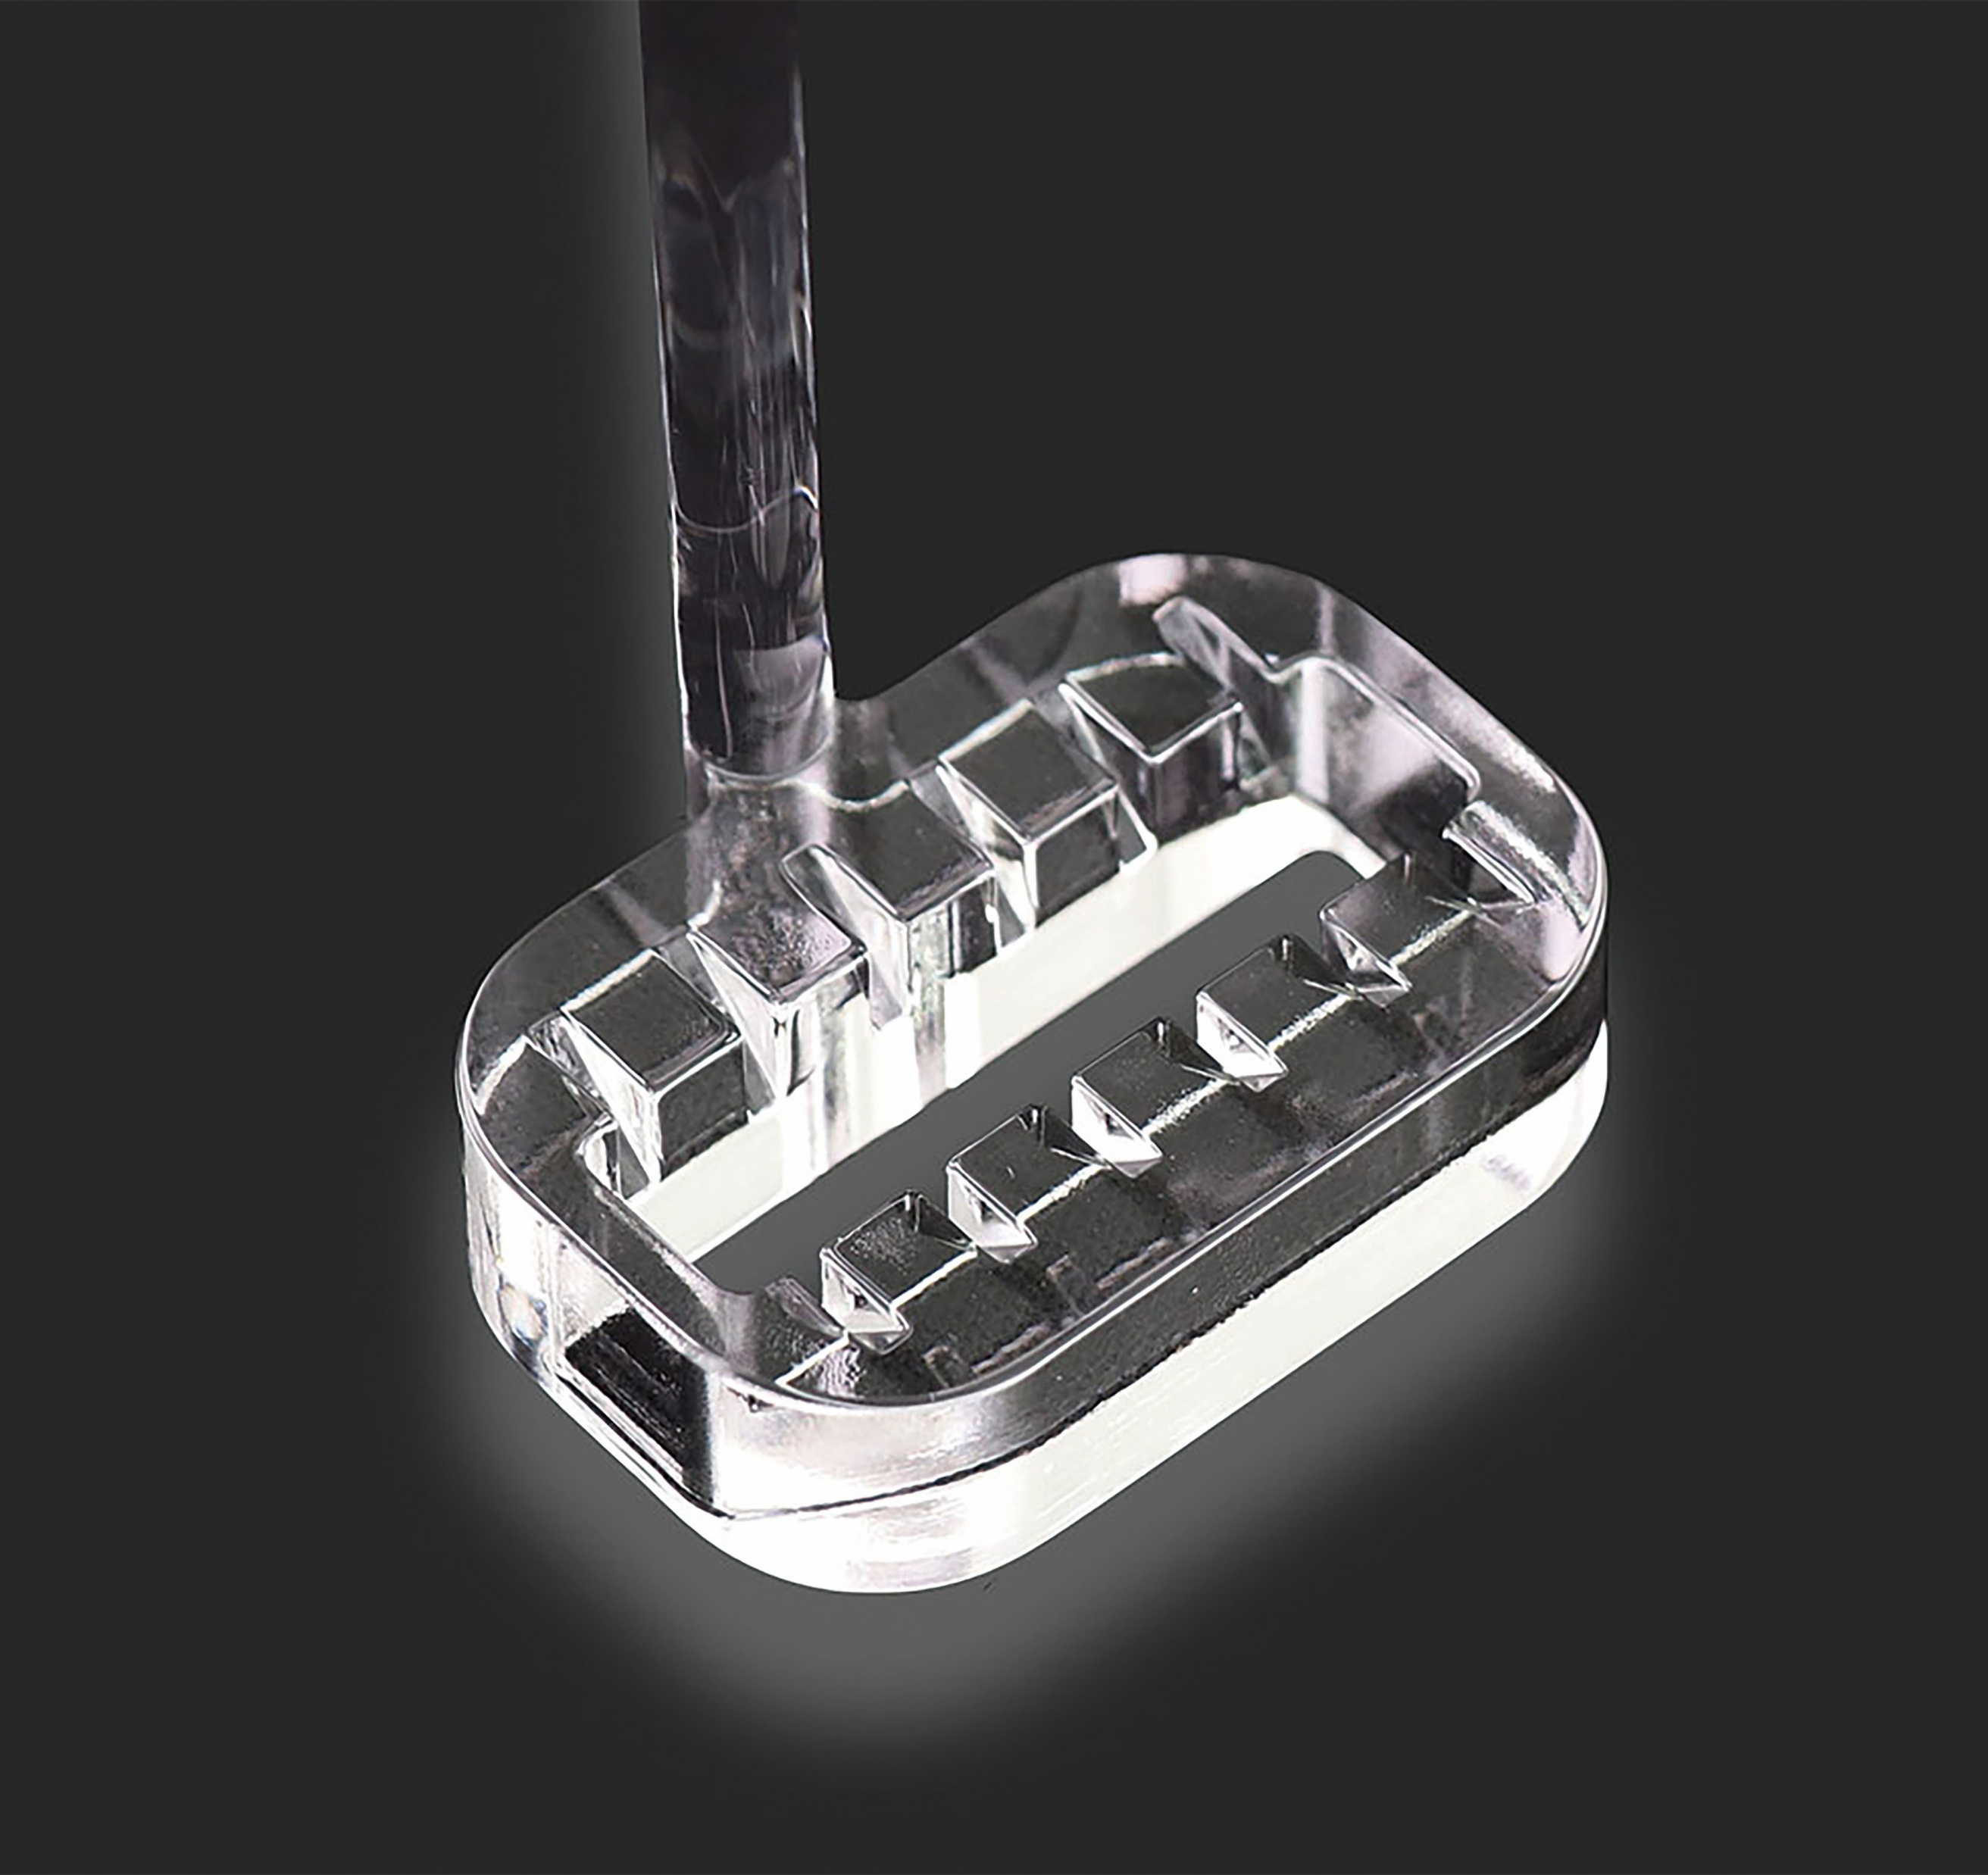
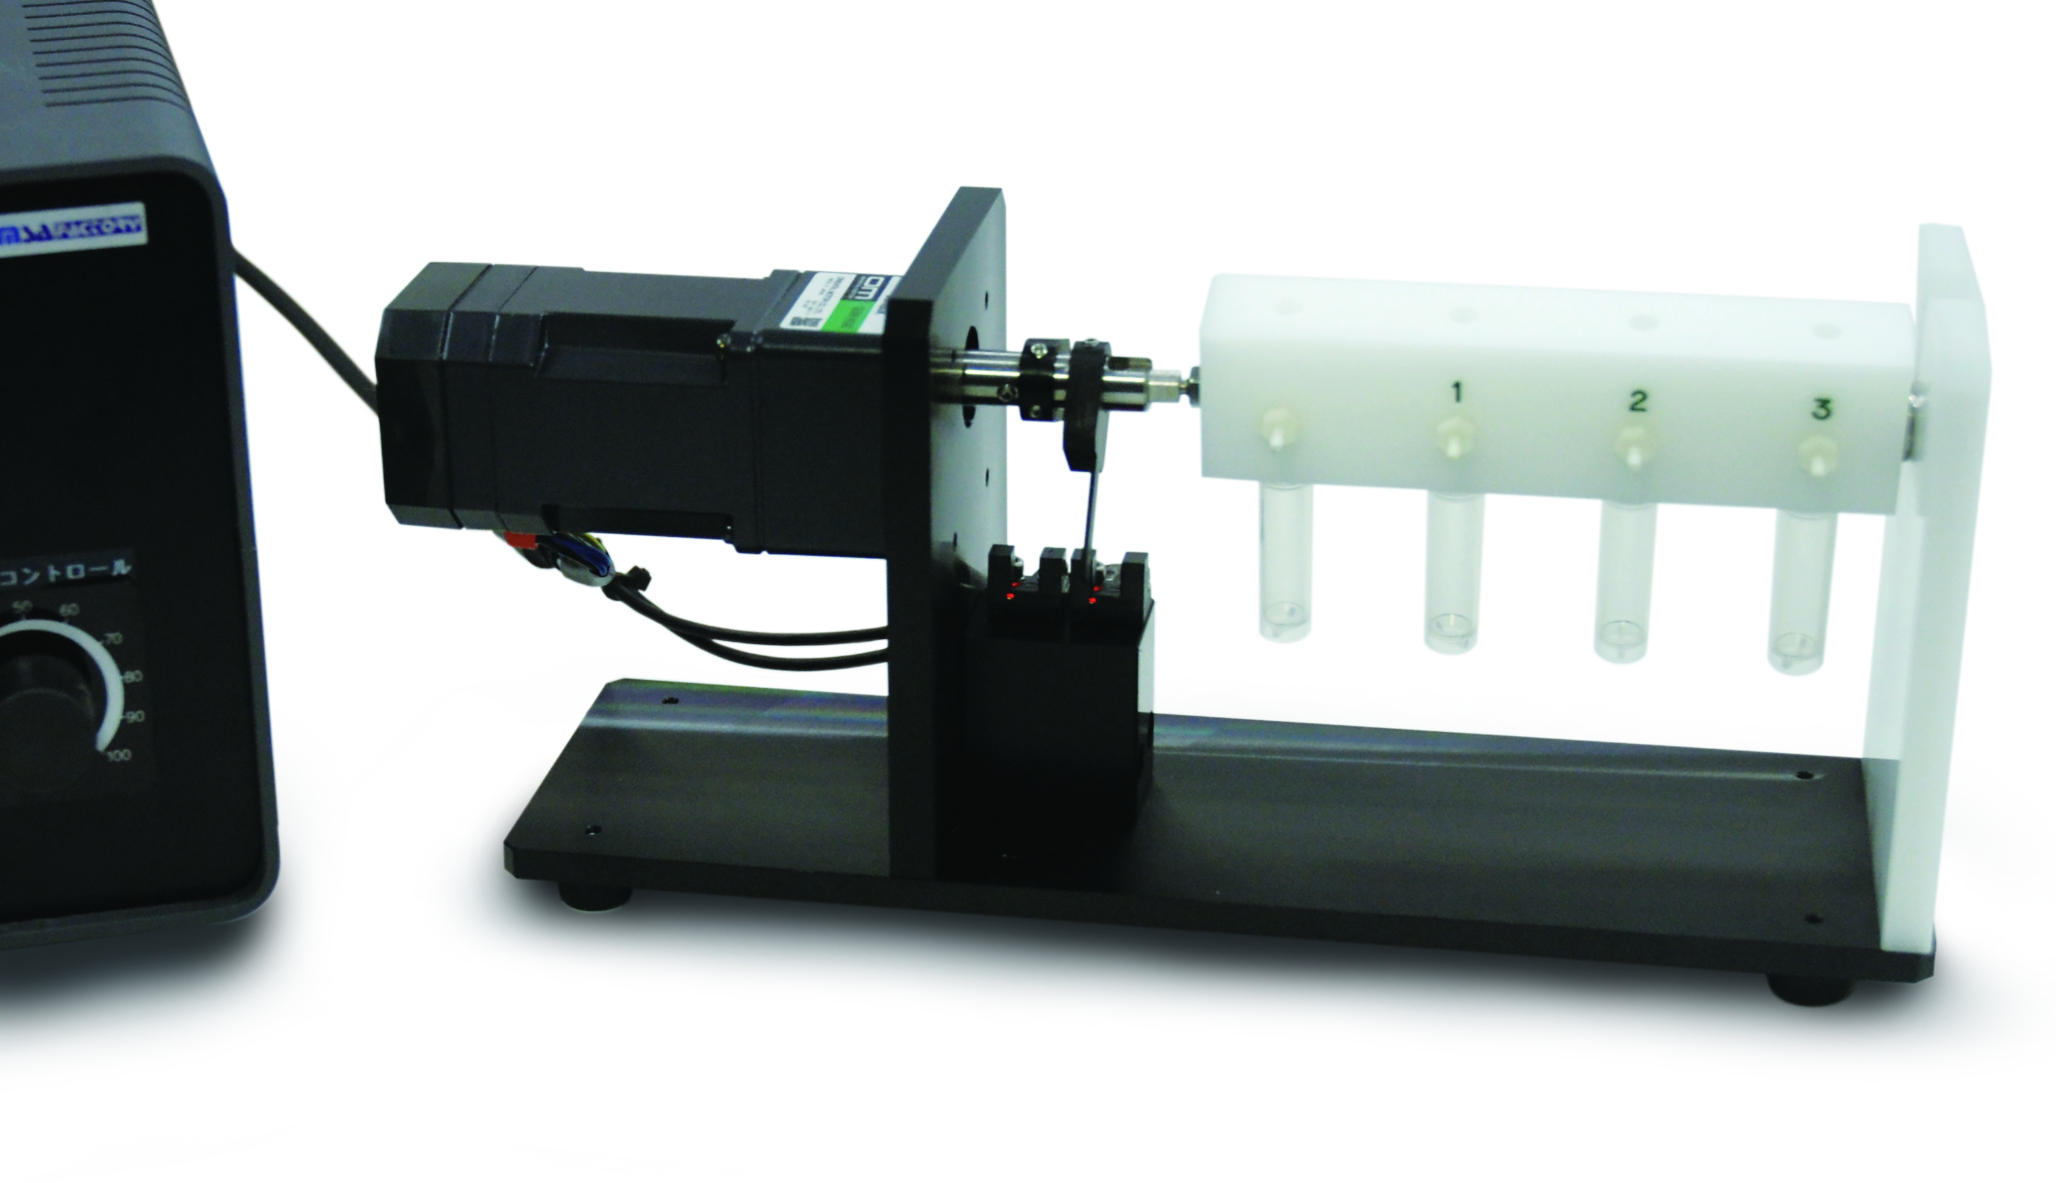
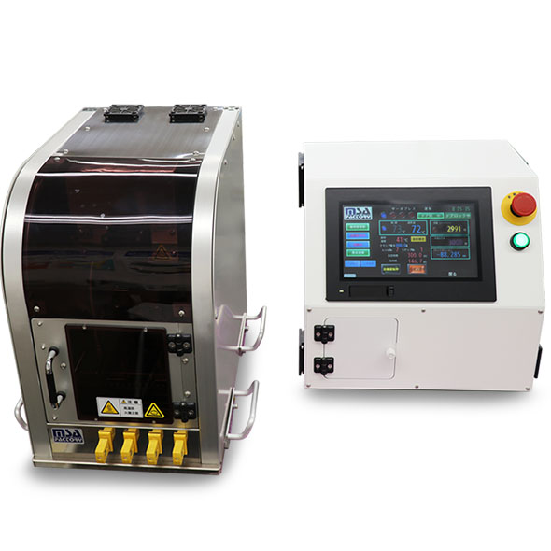
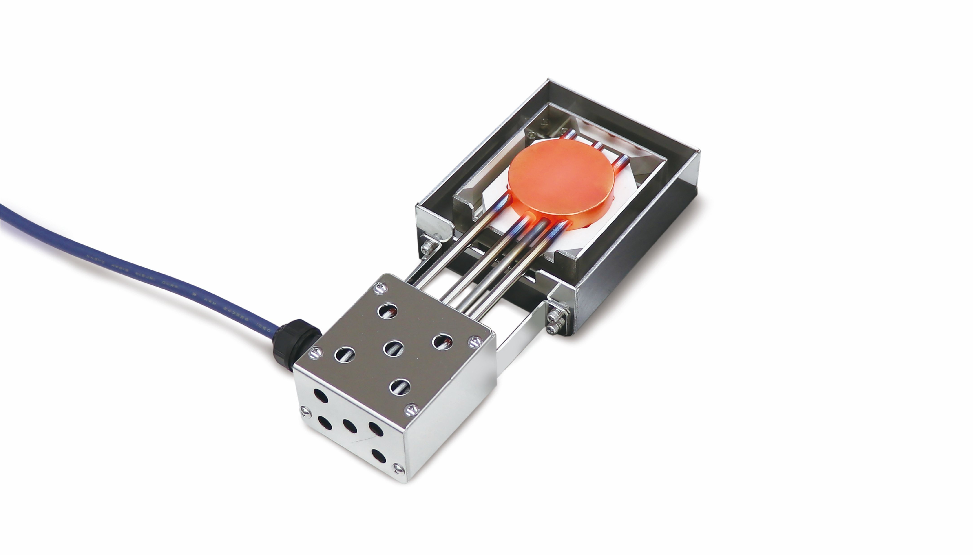
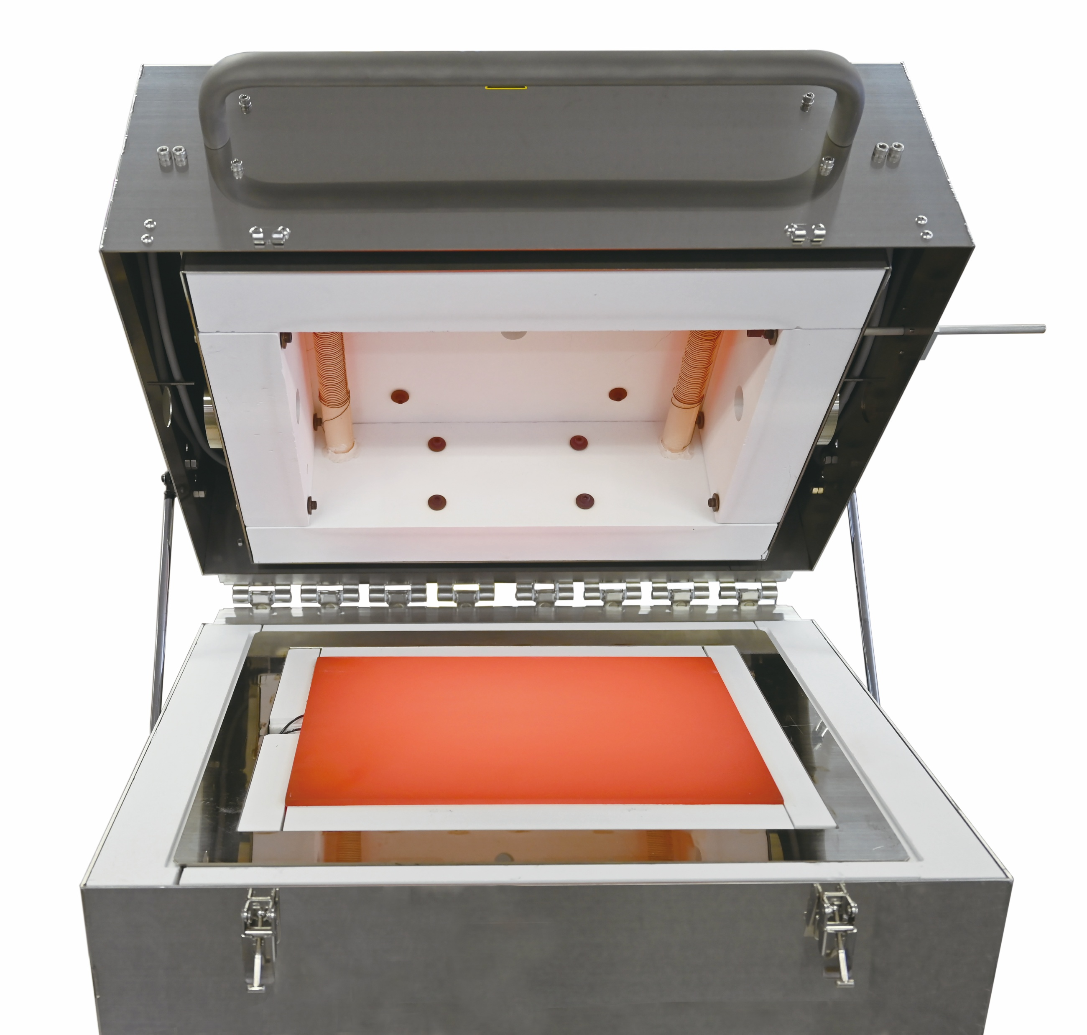
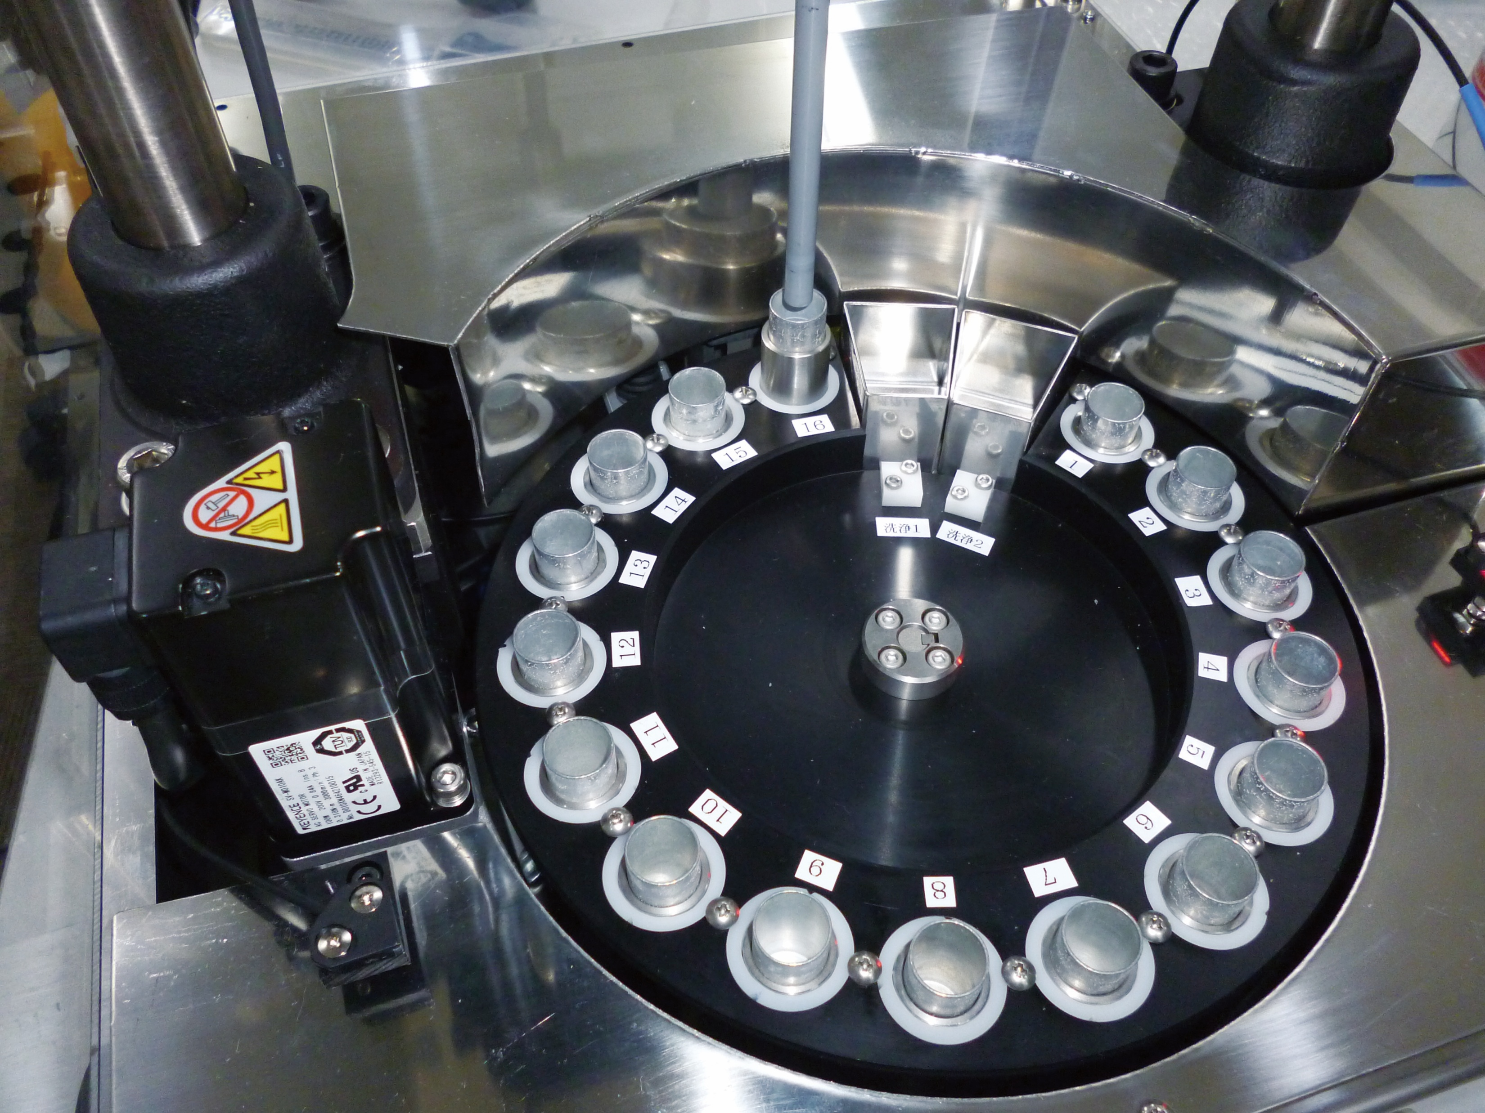
Custom Solutions for Laboratories and Research Facilities
MSA Factory designs and manufactures highly precise and flexible custom equipment for laboratories and research.
Heating, stirring, and pressing devices that streamline sample pretreatment such as homogenization and drying
Specialized holders and fixtures for extreme conditions such as vacuum, cryogenic, or high-temperature environments
Support for developing innovative analytical instruments equipped with automated dispensing and precise temperature control
Compact designs that allow seamless integration with existing systems

Slide 2
カスタム対応品
分析 前処理工程
Sample Pretreatment Process
Custom Aluminum Blocks
Customized Products
Custom aluminum blocks available
No need to prepare detailed drawings – production is possible based on dimension specifications alone
Supports customization of hole shape, number/arrangement, material, and surface treatment
Available from a single piece, withort lead times and cost-effective pricing

Slide 3
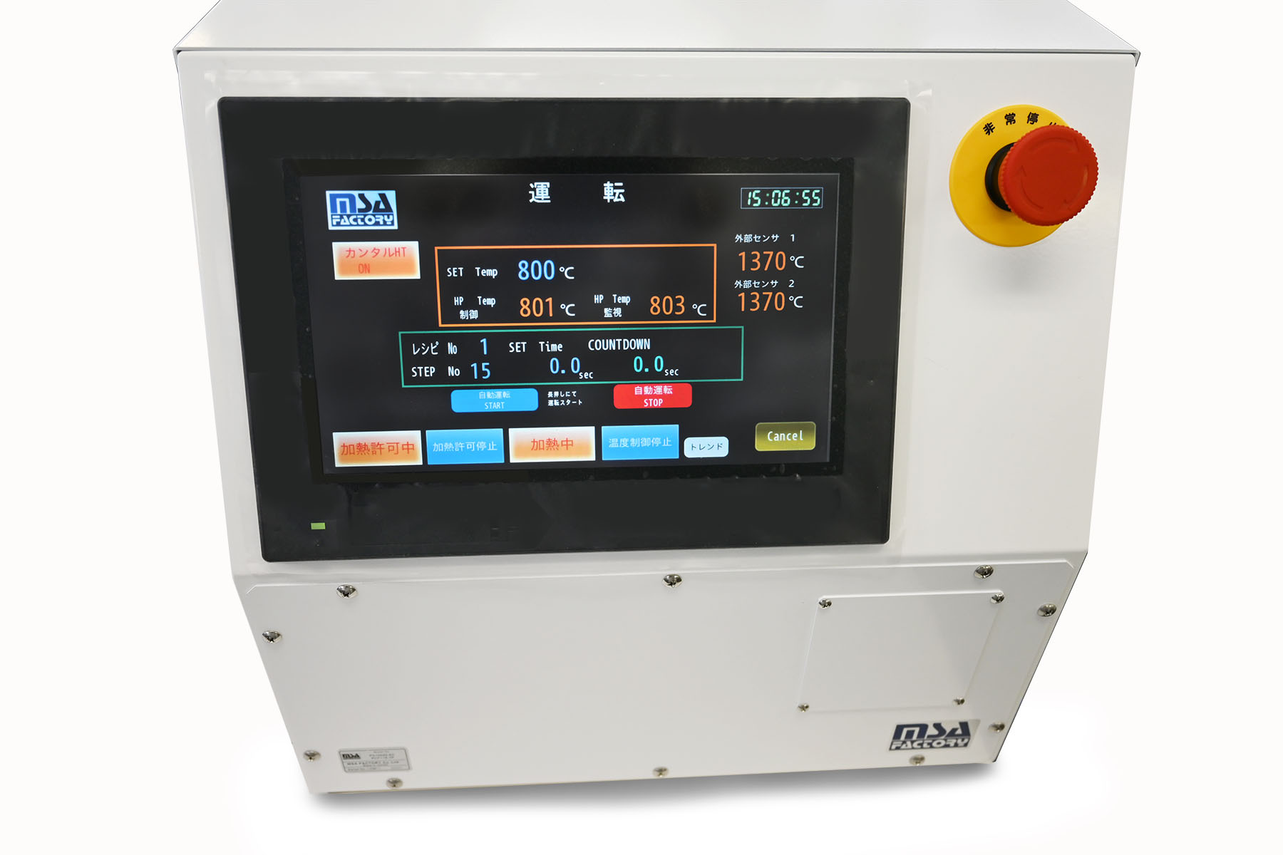
カスタム対応品
Sample Pretreatment Process
分析 前処理工程
・High-Temperature Furnace MV10000 Series (Max 1000℃)
・High-Temperature Hot Plate PA10000 Series (Max 1000℃)
・Heating equipment capable of reaching up to 1000℃
・Industry-leading hot plate with maximum temperature of 1000℃
・Ideal for ashing and pretreatment of inorganic samples
・Atmosphere can be controlled by introducing gas flow
・Volatile substances are safely exhausted through a duct system
Dedicated Controller for
MV10000 Series
Ultra-High Temperature
Heating Equipment
PA9005

Slide 4
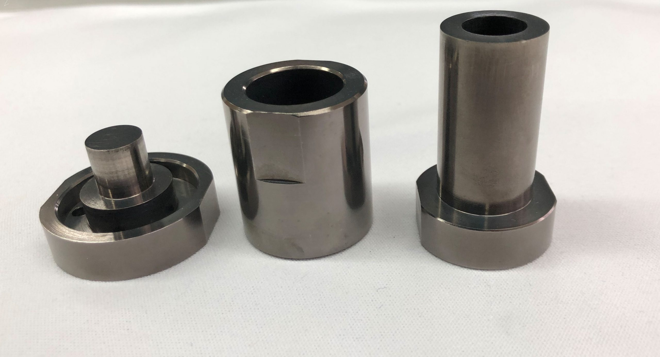
カスタム対応品
分析 前処理工程
Sample Pretreatment Process
・Hot Press System (up to 800℃)
・Suitable for powder compaction, pre-sintering, and tablet crushing
・Available in both parallel-plate type and furnace-integrated type
・Custom molds can be designed and manufactured to match the press system
・Various press mechanisms available:
Manual press,Hydraulic (high force),Pneumatic
(low force, high precision stability),Servo-motor driven
(high force, high precision, automated operation)

Slide 5
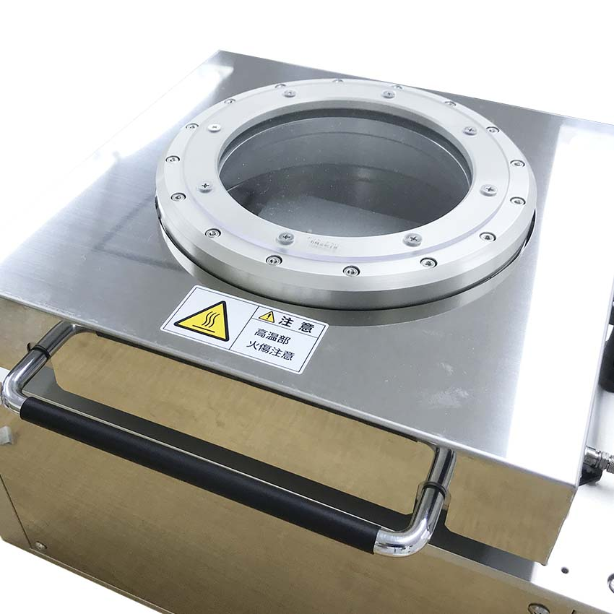
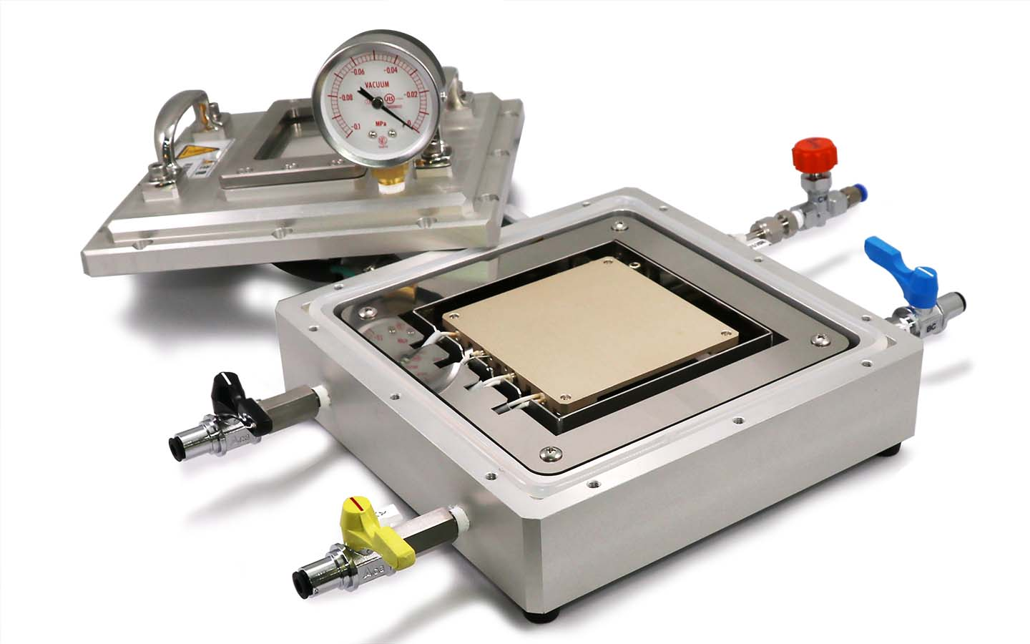
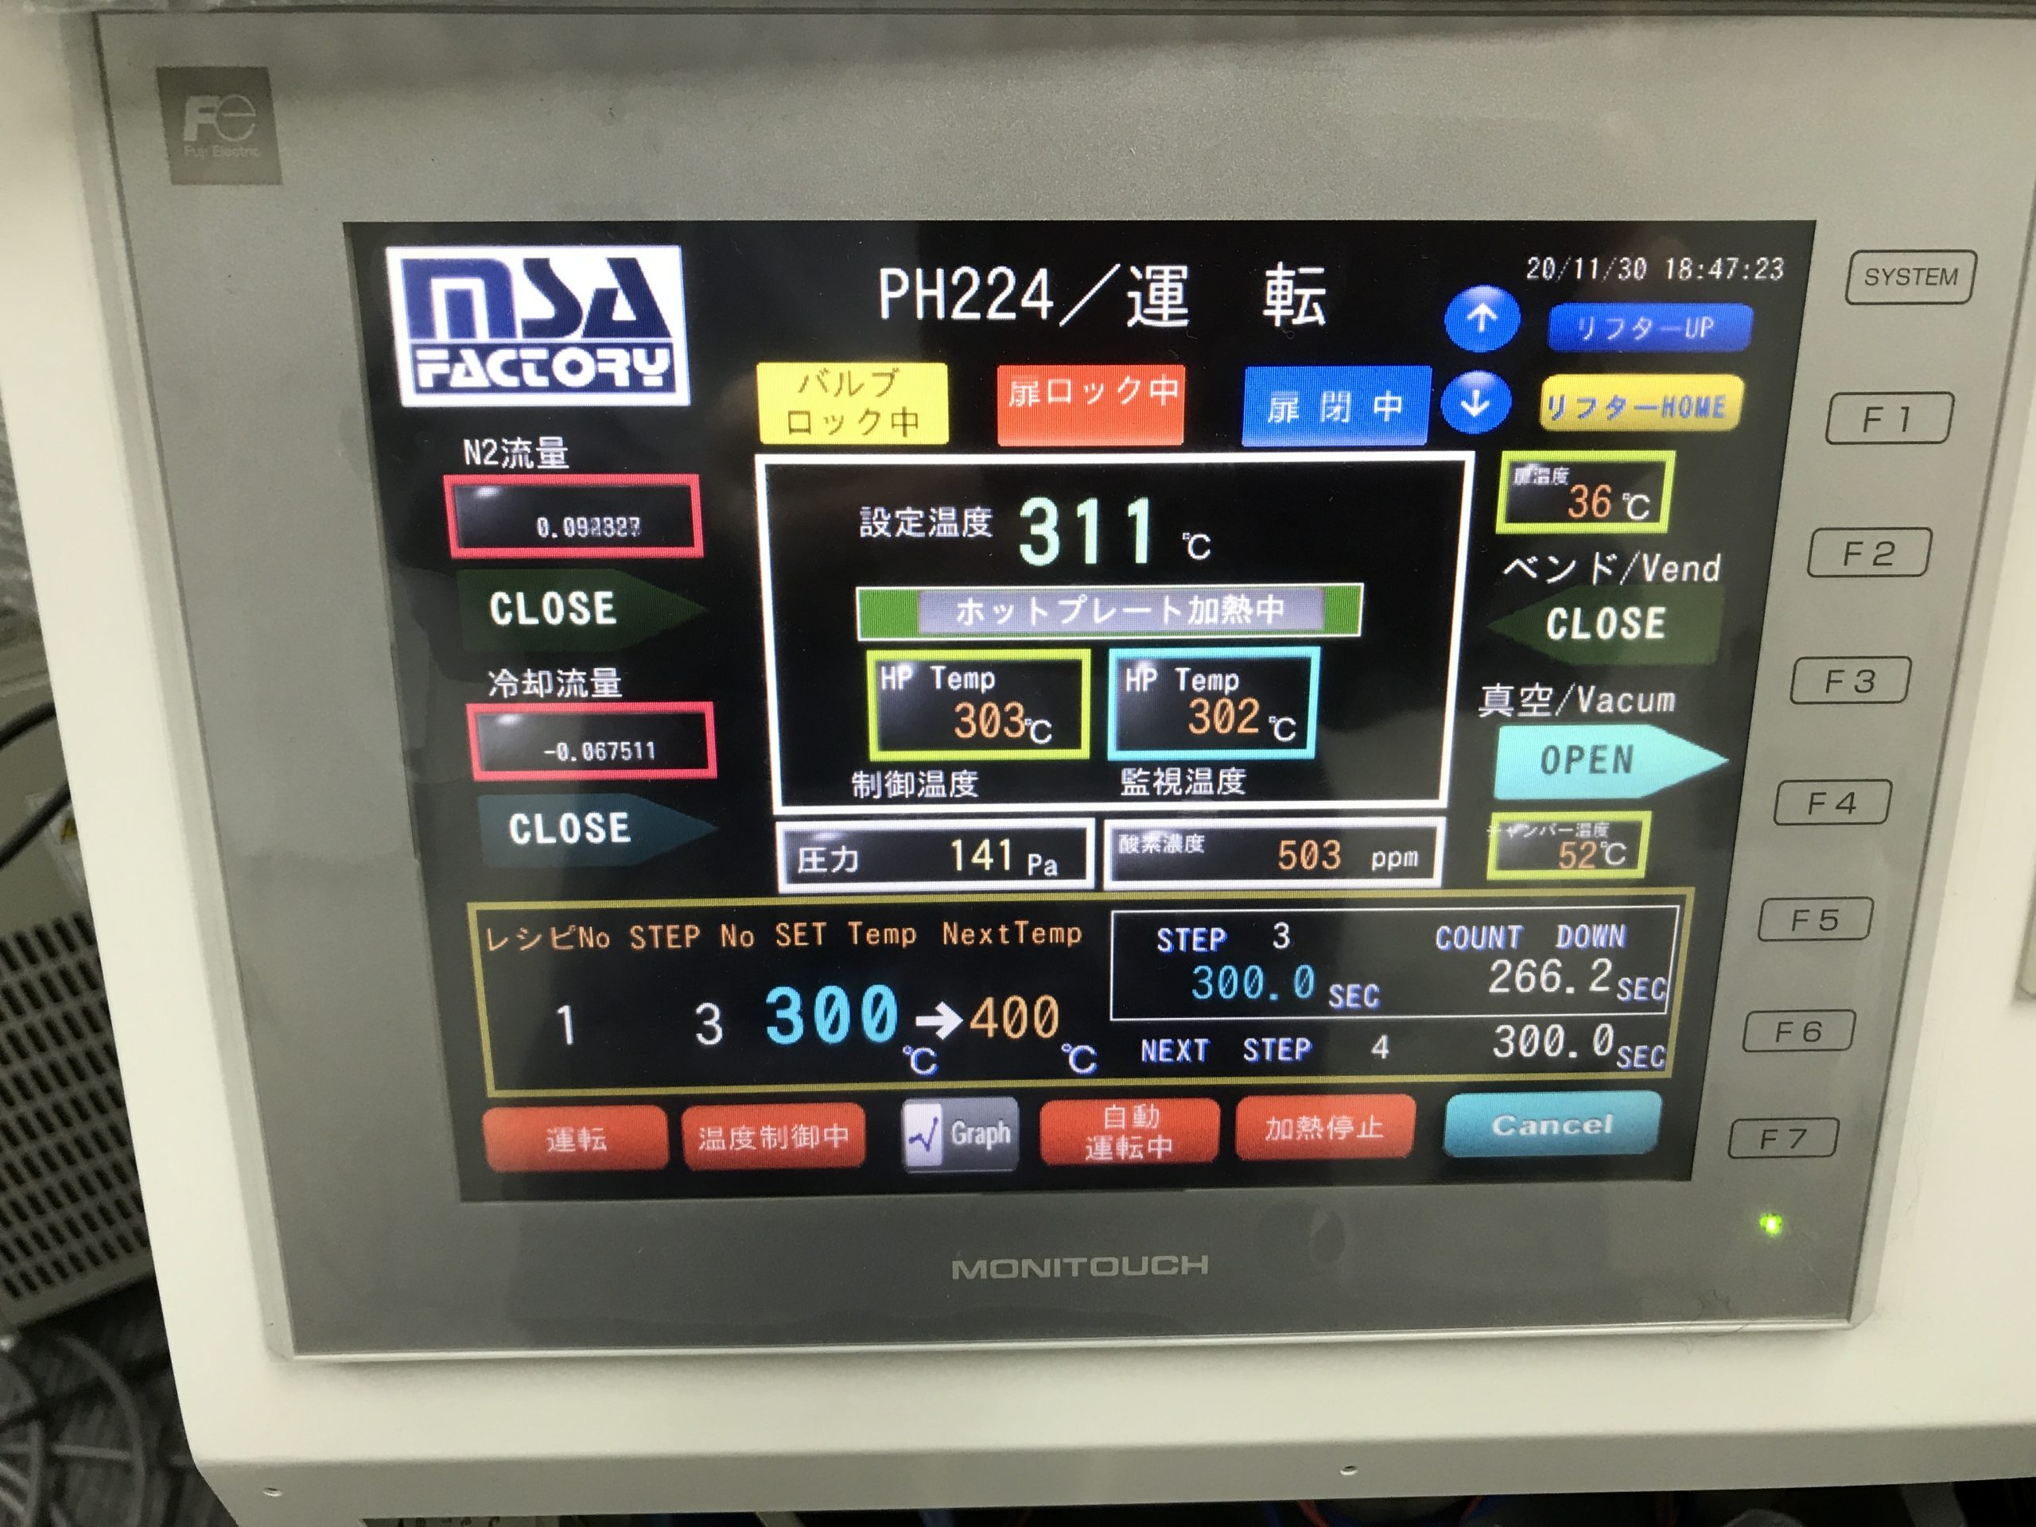
カスタム対応品
分析 前処理工程
Customized Products – Vacuum Drying / VCD
・Designed for volatile solvent drying processes
・Hot plate–based vacuum heating system for VCD applications
・Unlike environmental heating, direct heat conduction via hot plate
enables high-speed processing
・Easy process management with a touchscreen controller
・Series also includes small-scale evaluation models and manual
heating systems
Automated Vacuum Heating
/ VCD System – PH225 Series
Controller screen during
automated operation
Manual Vacuum Heating
/ VCD System – PH222 Series

Slide 6
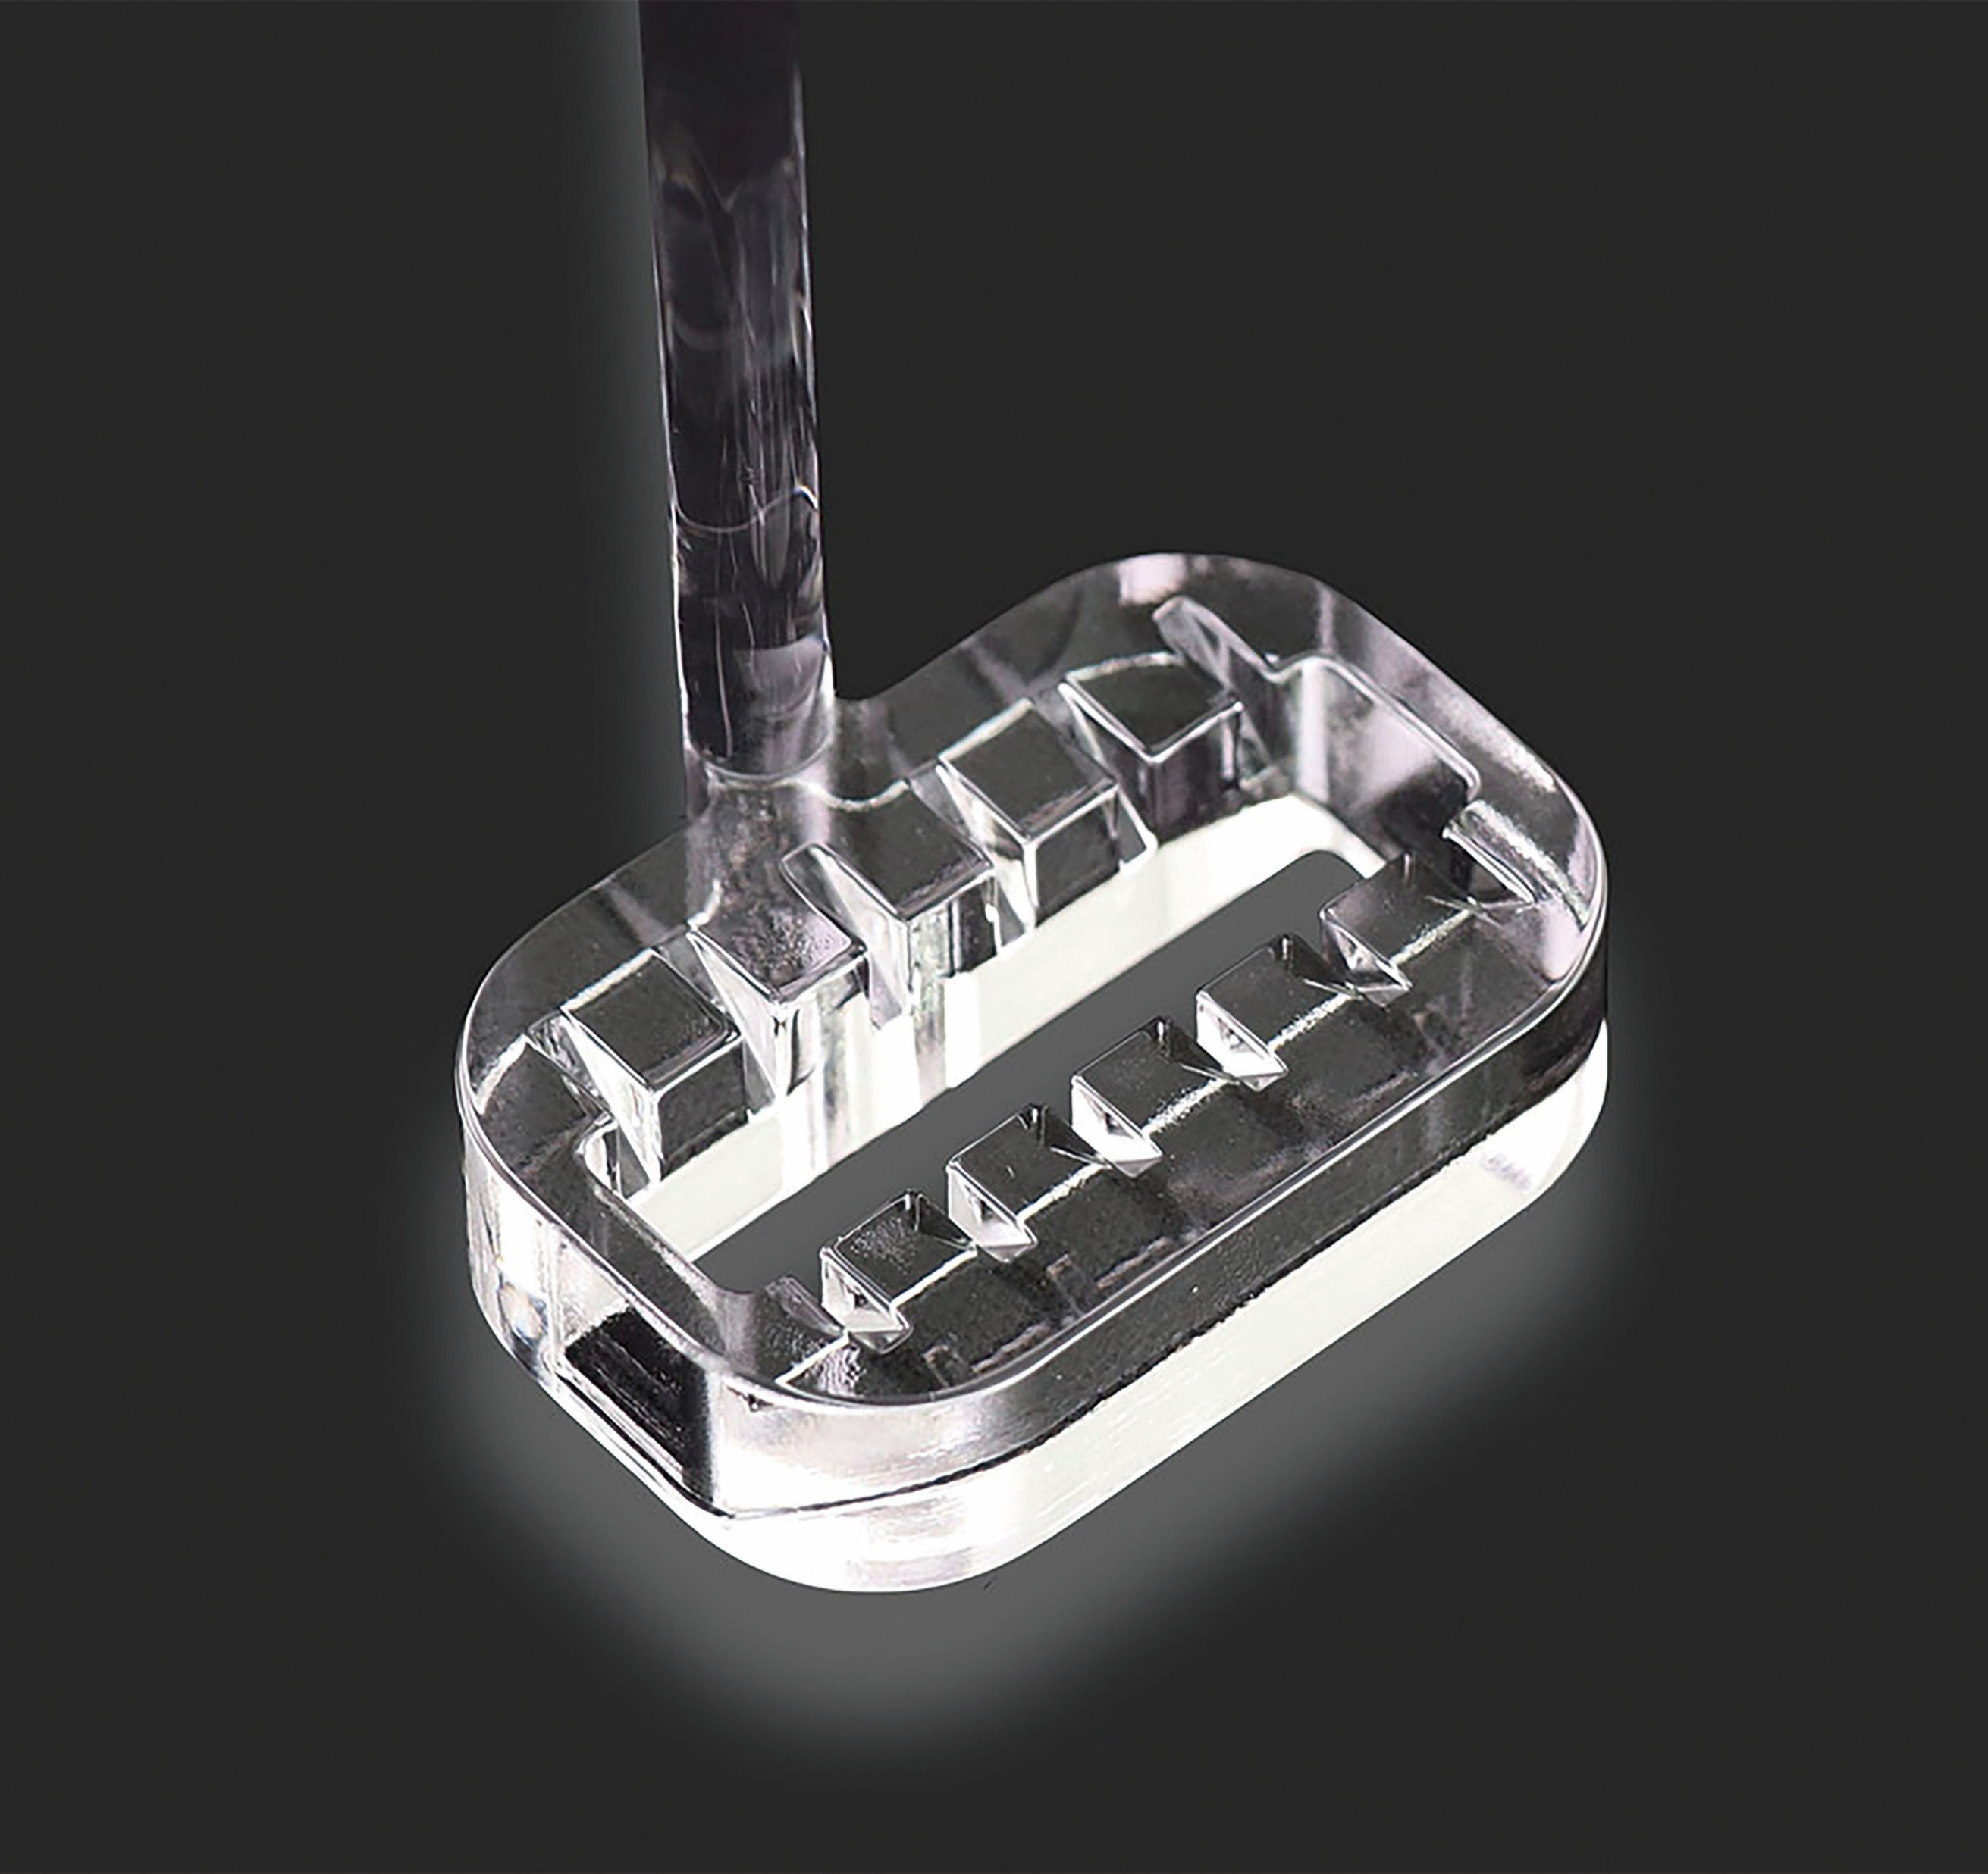
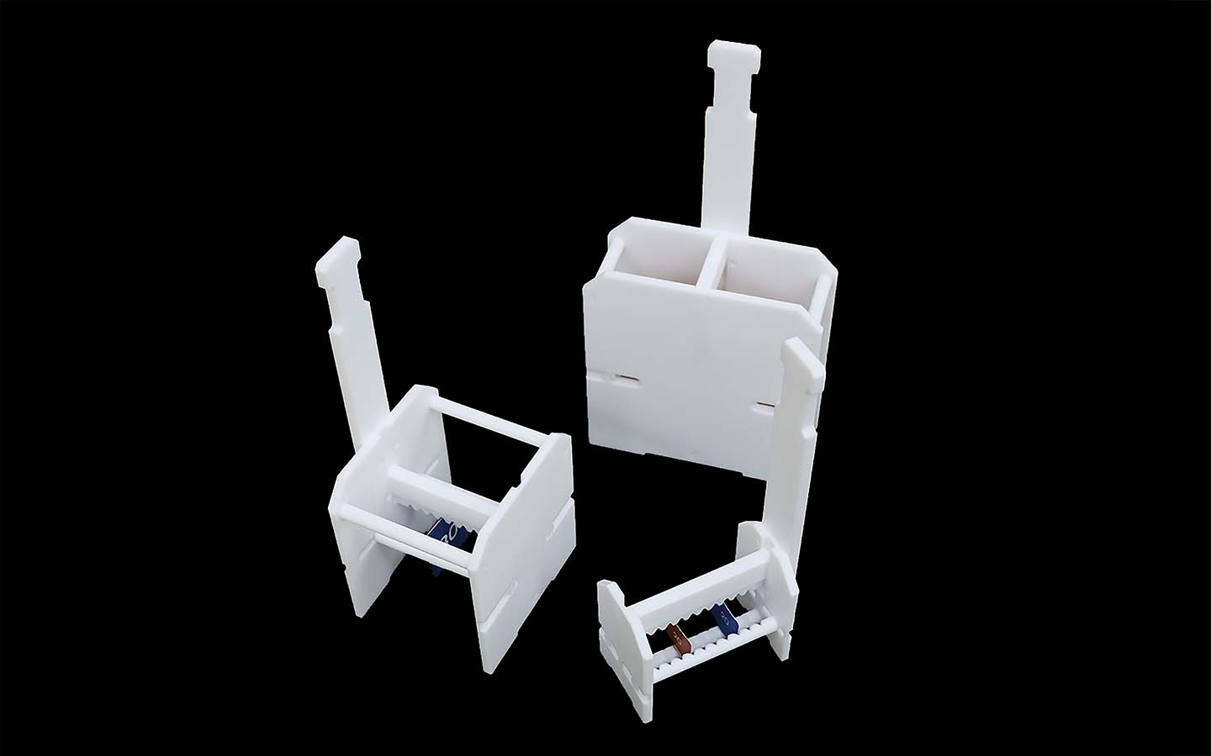
カスタム対応品
分析 前処理工程
Quartz Glass Carriers
・Quartz Glass Carriers (Standard & Custom Options)
・ Suitable for chemical processing, etching, cleaning, and
degreasing applications
・ Wide range of shapes and sizes available
・In addition to quartz glass, cost-effective Teflon versions (PTFE, PFA)
are also offered
Teflon Carrier
– STF Series
Quartz Glass Carrier – SGF Series

Slide 7
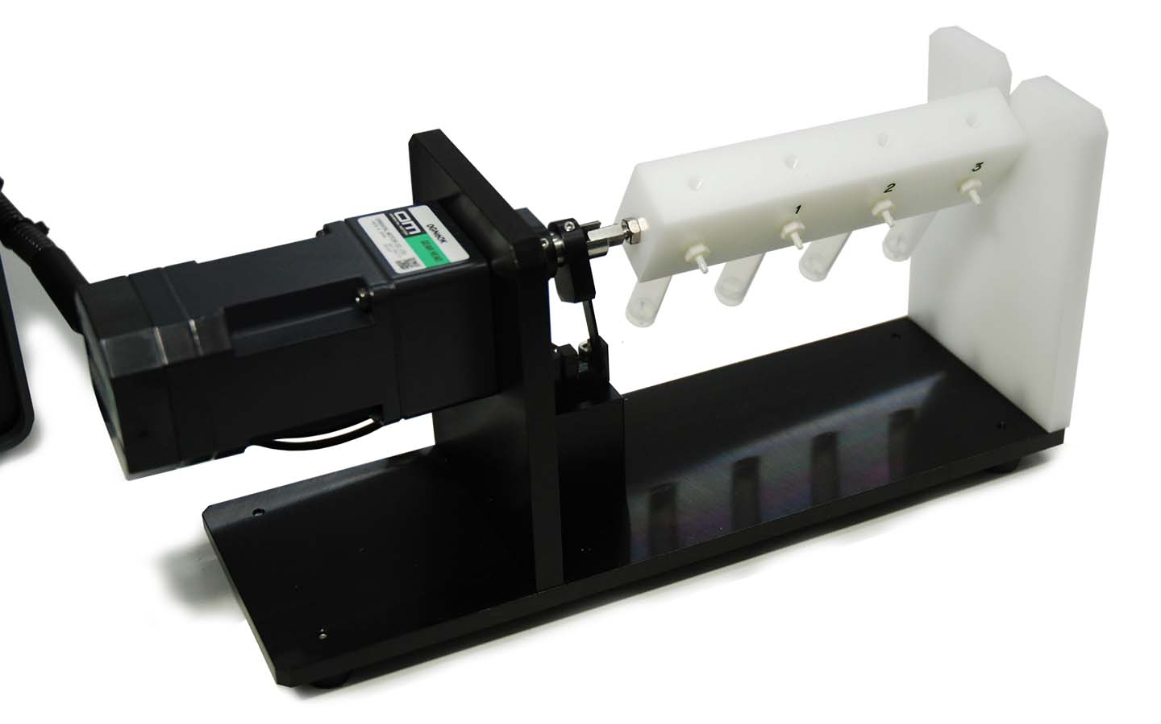

カスタム対応品
Custom Stirring & Shaking Systems
分析 前処理工程
・Custom Stirring & Shaking Systems
・ Custom-built for applications requiring stronger stirring or shaking performance
・ Adapters can be designed to fit your existing containers
・Options available for integration with constant-temperature baths (temperature-controlled operation)
動画 Yuotube

Slide 8
Automated Homogenizer Processing
カスタム対応品
分析 前処理工程
Homogenizers
Process Automation
Improvement:
automated system
integration
Conventional method
: manual operation
Stand
Sample
Your existing homogenizer can be upgraded
for fully automated operation

Slide 9
High-Temperature Material Evaluation Systems
カスタム対応品
分析 前処理工程
Material evaluation using a Digital Servo Hot Press
応用・評価
①Capability for ultra-high temperatures
②Precision load control
③Recipe registration for parameters such as time and load
Servo motor–driven load application with load cell monitoring
Servo motor–driven load application with load cell monitoring
Heating Plate: up to 900℃
Heating Plate: up to 900℃
Sample
Sample
Hot Plate Shutter(OP)
Additional Thermocouple(OP)
Heat Flux Sensor(OP)
Heating Plate: up to 900℃
Plate 25℃
Thermal conductivity, heat resistance, and flammability testing of inorganic materials and thermal insulation
LoadCell
LoadCell
Double-sided heating for uniform
thermal processing
Single-Sided Heating – Material Evaluation

Slide 10
High-Speed Process PCR System
応用・評価
カスタム対応品
High-Speed Process PCR System – Configuration Diagram
Sample detection /Observation camera (Optional)
Visualization of Virus Behavior
in Response to Temperature Variation
High Temp Rate
10℃/sec
WideRengeTemp
25~110℃
９６Well
Glass
Temperature cycling plate : 25 ~ +110 ℃
PGーPR
Peltier element
Cooling water circulation from chiller
Water-cooled plate

Slide 11

Temperature Cycling / Thermal Property Test
応用・評価
Temperature Cycling / Thermal Property Test
– Configuration Diagram
CCD Camera(OP)
カスタム対応品
Sample/Workpiece
Electrical signal probe
(Optional)
Glass
PG 1506
Temperature
cycling plate
: -40 ~ +150 ℃
N₂ gas (or dry air) for condensation prevention
Peltier element
Cooling water circulation
from chiller
Water-cooled plate
XY stage / Position adjustment function

Slide 12
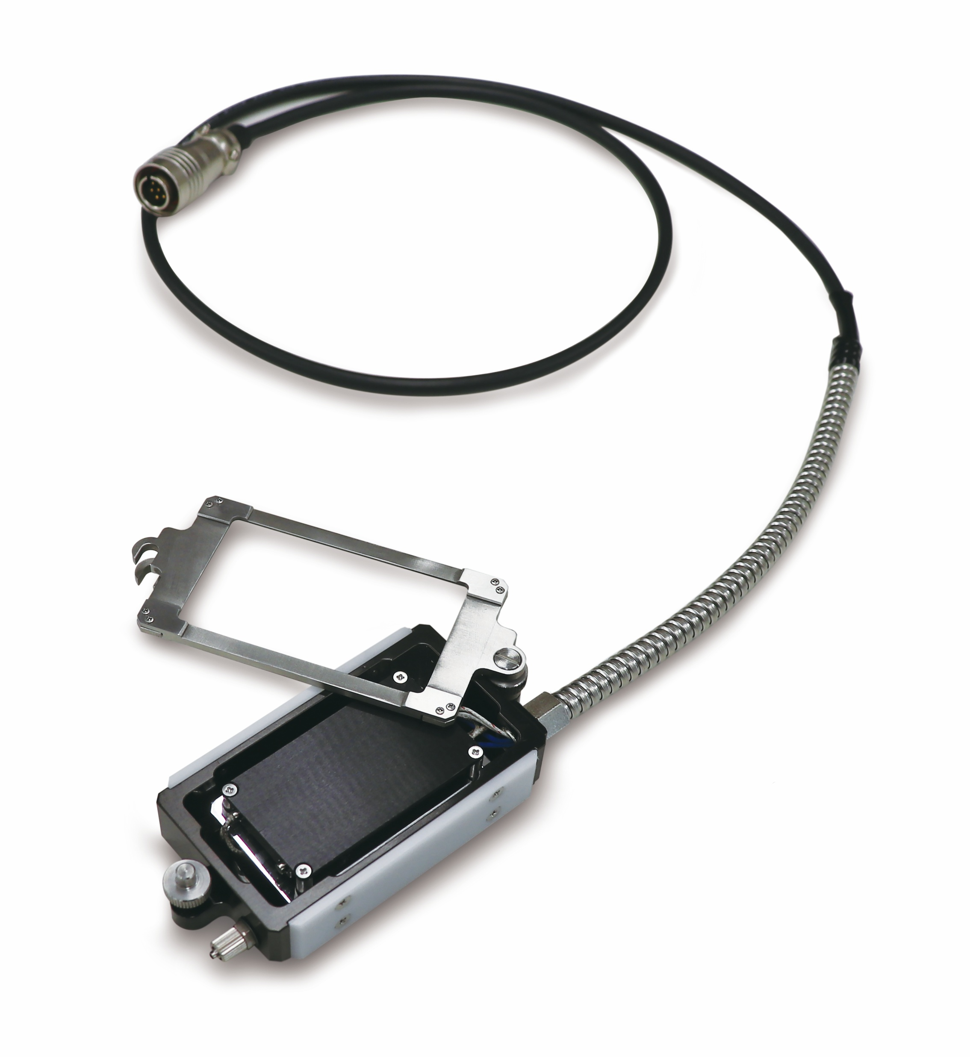
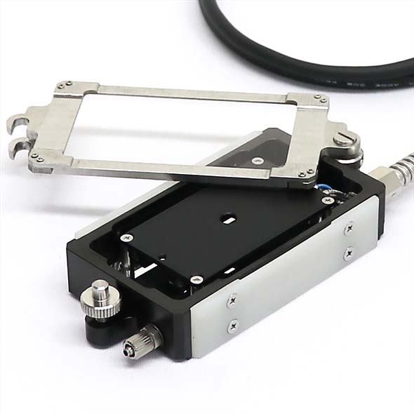
カスタム対応品
応用・評価
Heating Stage for Microscopy
Visualize material behavior
under temperature changes
・Available in 200℃ / 400℃ versions
・Uses standard temperature controllers for cost efficiency
・Reliable Made in Japan quality support
・Optional PG Series allows low-temperature observation
・Atmosphere adjustable with gas flow (e.g., N₂, CO₂); optional flow control (-FL) available
・Heating stage surface is black for optimized microscopic observation
60×34mm
Microscope Heating Stage
– PN Series
Transmission Type
– PN-D Series

Slide 13
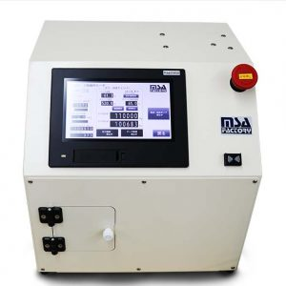
カスタム対応品
Custom Bioreactors
応用・評価
・Visualize biological or material behavior under temperature changes
・Designed for applications such as cell culture, microorganisms, algae, enzymes, and plant research
・Equipped with a 10” color touchscreen controller for intuitive operation
・Functions include:Gas flow control、Temperature control、Data logging of sensors (temperature, pH, DO, etc.)、Stirring condition monitoring and adjustment
Minimizes operator variability through automated control
Example: customized stirring
fin design and rotation speed
optimized for evaluation needs

Slide 14
カスタム
Contact – Custom Analysis & Evaluation Instruments
株式会社MSAファクトリー/MsaFactory.,Co.Ltd
https://msa-factory.co.jp
info@msa-factory.co.jp
+81-3-6276-7873
Honmachi1-21-1,Shibuya-ku Tokyo Japan Zip151-0071
東京都渋谷区本町1-21-1 SH小林ビル 5F
Shinyokohama1-14-20-601,Kohoku-ku Yokohama Kanagawa Zip 222-0033
神奈川県横浜市港北区新横浜1-14-20光正第２ビル

